Slide 1
Fourier series Representation of CT Periodic Signals

Slide 2
INTRODUCTION
Here we explore an alternative representation for signals and LTI systems. It is based on the development of a representation of signals as linear combinations of a set of basic signals. For this alternative representation we use complex exponentials.
The resulting representation are known as the CT and DT Fourier series and transform.

Slide 3
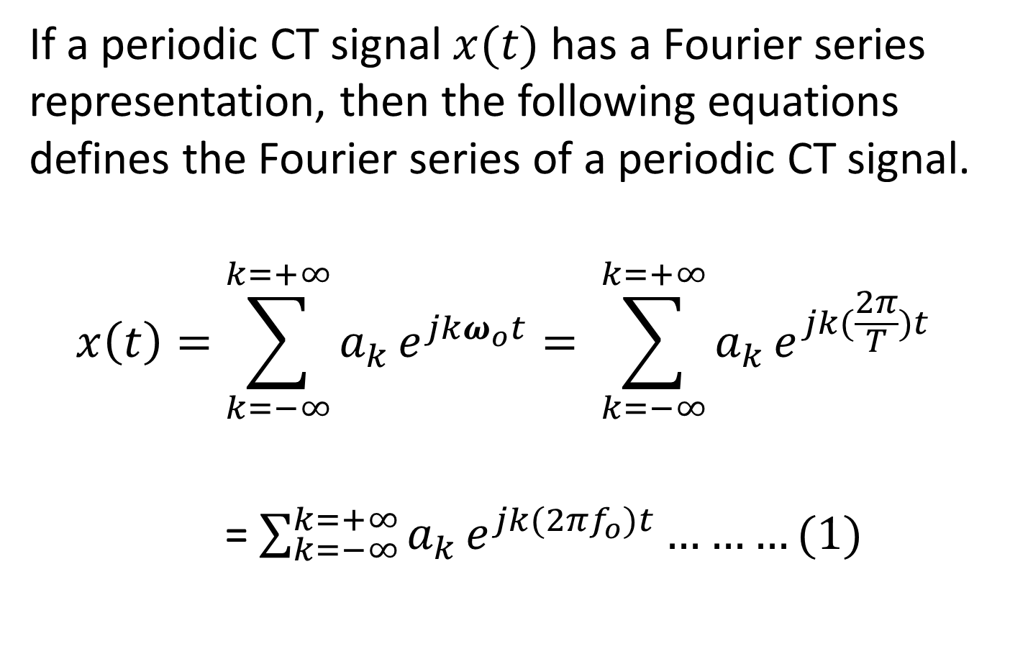
.
If a periodic CT signal $x(t)$ has a Fourier series representation, then the following equations defines the Fourier series of a periodic CT signal.
$$x\left(t\right)=\sum_{k=−∞}^{k=+∞}{a_{k}}e^{jkω_{o}t}= \sum_{k=−∞}^{k=+∞}{a_{k}}e^{jk(\frac{2π}{T})t}$$
= $\sum_{k=−∞}^{k=+∞}{a_{k}}e^{jk(2πf_{o})t}………(1)$

Slide 4
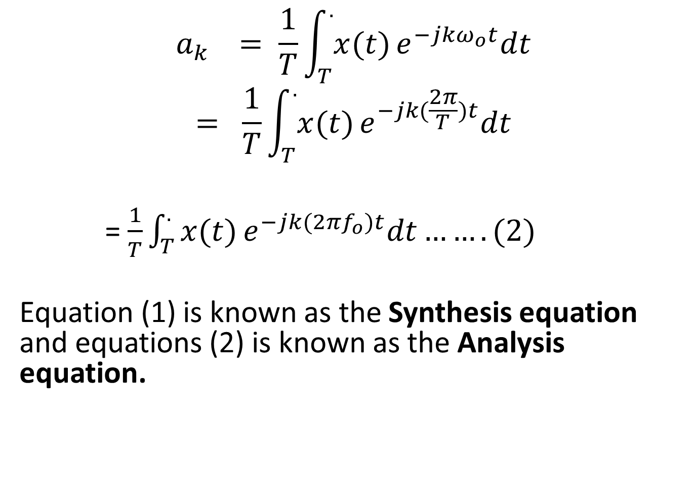
$$a_{k} = \frac{1}{T}\int_{T}^{.}{x(t)}e^{−jkω_{o}t}dt$$
$$= \frac{1}{T}\int_{T}^{.}{x(t)}e^{−jk(\frac{2π}{T})t}dt$$
= $\frac{1}{T}\int_{T}^{.}{x(t)}e^{−jk(2πf_{o})t}dt…….(2)$
Equation (1) is known as the Synthesis equation and equations (2) is known as the Analysis equation.

Slide 5
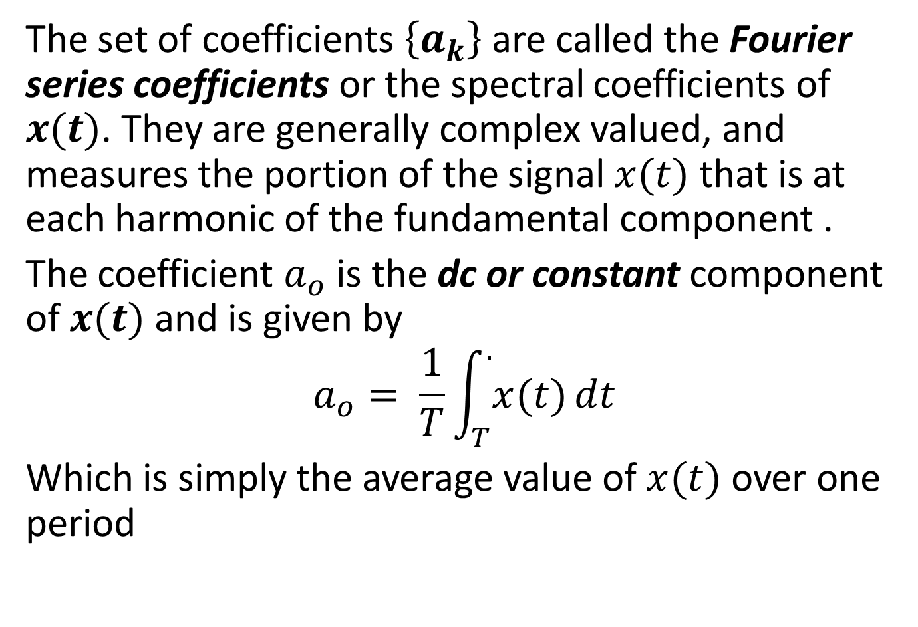
The set of coefficients $\left\{a_{k}\right\}$ are called the Fourier series coefficients or the spectral coefficients of $x(t)$. They are generally complex valued, and measures the portion of the signal $x(t)$ that is at each harmonic of the fundamental component .
The coefficient $a_{o}$ is the dc or constant component of $x(t)$ and is given by
$$a_{o}= \frac{1}{T}\int_{T}^{.}{x(t)}dt$$
Which is simply the average value of $x(t)$ over one period

Slide 6
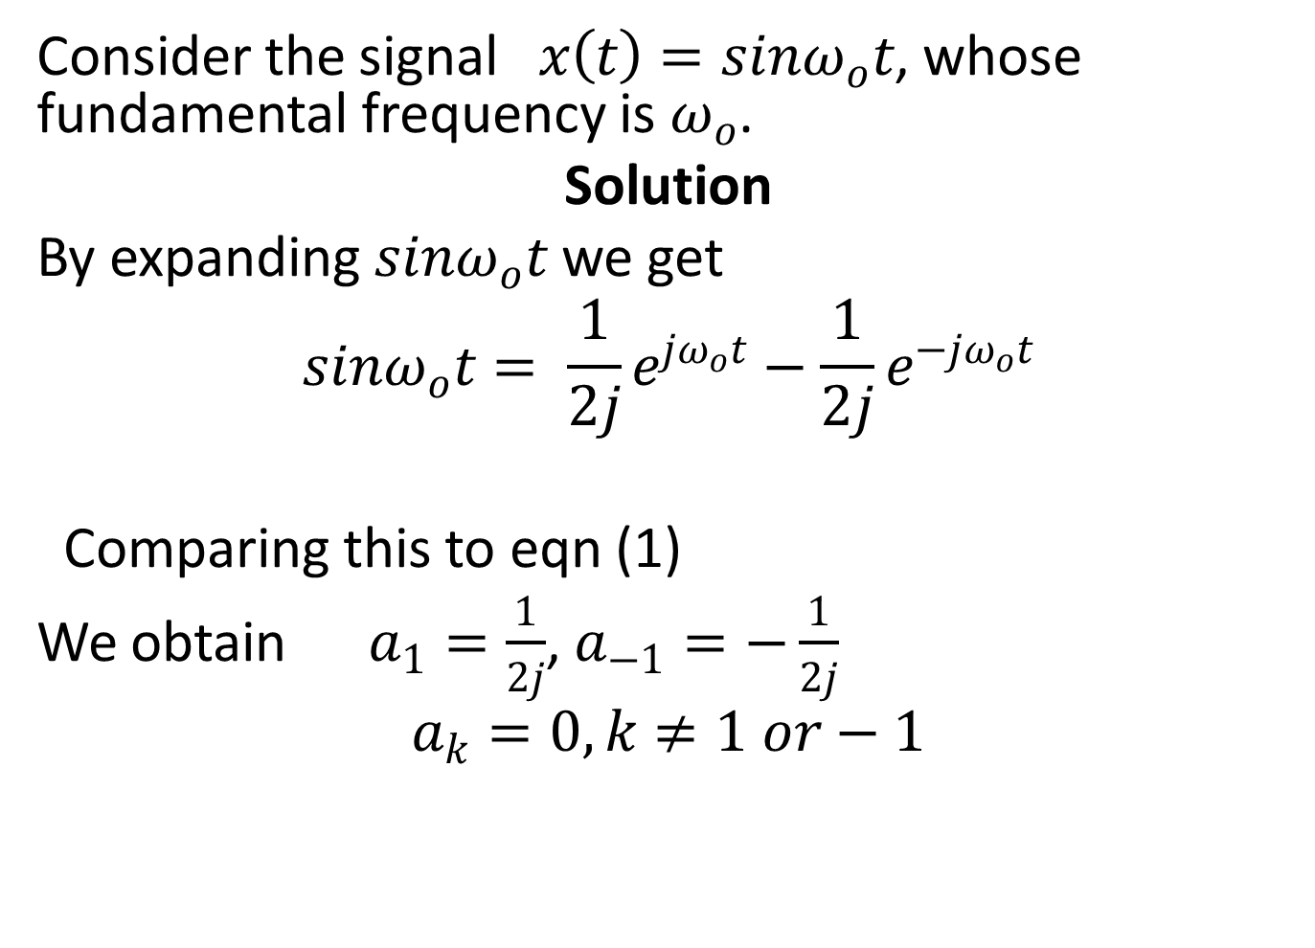
Example 1
Consider the signal$x\left(t\right)=sinω_{o}t$, whose fundamental frequency is $ω_{o}$.
Solution
By expanding $sinω_{o}t$ we get
$$sinω_{o}t= \frac{1}{2j}e^{jω_{o}t}−\frac{1}{2j}e^{−jω_{o}t}$$
Comparing this to eqn (1)
We obtain $a_{1}=\frac{1}{2j}$, $a_{−1}=−\frac{1}{2j}$
$$a_{k}=0, k≠1 or−1$$

Slide 7
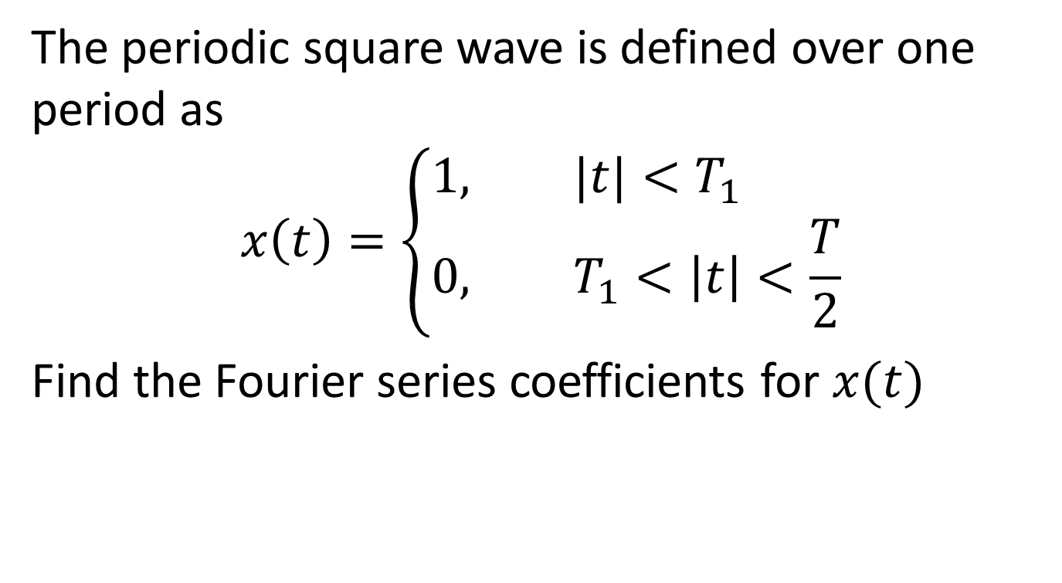
Example 2
The periodic square wave is defined over one period as
$$x\left(t\right)=\left\{\begin{aligned}1, &|t|<T_{1} \\ 0, &T_{1}<\left|t\right|<\frac{T}{2}\end{aligned}\right.$$
Find the Fourier series coefficients for $x(t)$

Slide 8
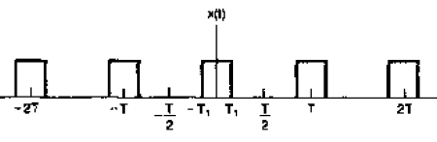
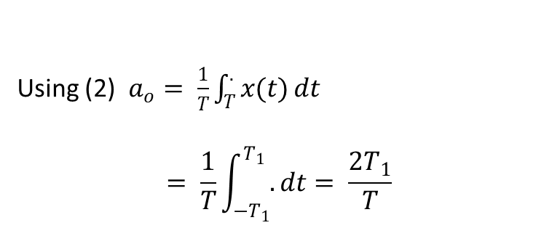
Solution
Because of symmetry of $x(t)$, we can choose $\frac{T}{2} <\left|t\right|<−\frac{T}{2}$
Using (2) $a_{o}= \frac{1}{T}\int_{T}^{.}{x(t)}dt$
$$= \frac{1}{T}\int_{{−T}_{1}}^{T_{1}}{.}dt= \frac{2T_{1}}{T}$$

Slide 9
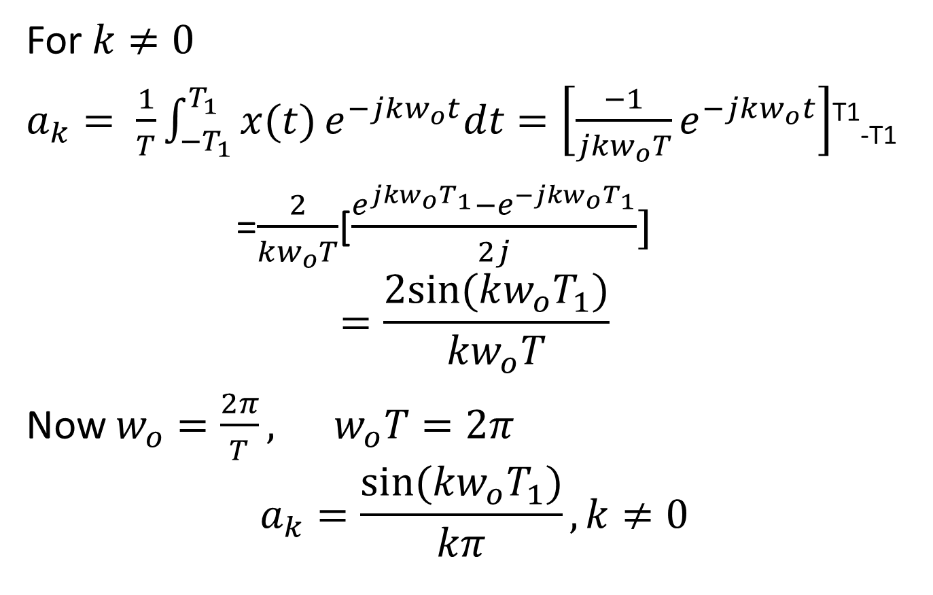
For $k≠0$
$a_{k}= \frac{1}{T}\int_{{−T}_{1}}^{T_{1}}{x(t)}e^{−jkw_{o}t}dt=\left[\frac{−1}{jkw_{o}T}e^{−jkw_{o}t}\right]$^{T1}_{-T1}
=$\frac{2}{kw_{o}T}$[$\frac{e^{jkw_{o}T_{1}}−e^{−jkw_{o}T_{1}}}{2j}]$
$$=\frac{2sin(kw_{o}T_{1})}{kw_{o}T}$$
Now $w_{o}=\frac{2π}{T}, w_{o}T=2π$
$$a_{k}=\frac{sin(kw_{o}T_{1})}{kπ},k≠0$$

Slide 10
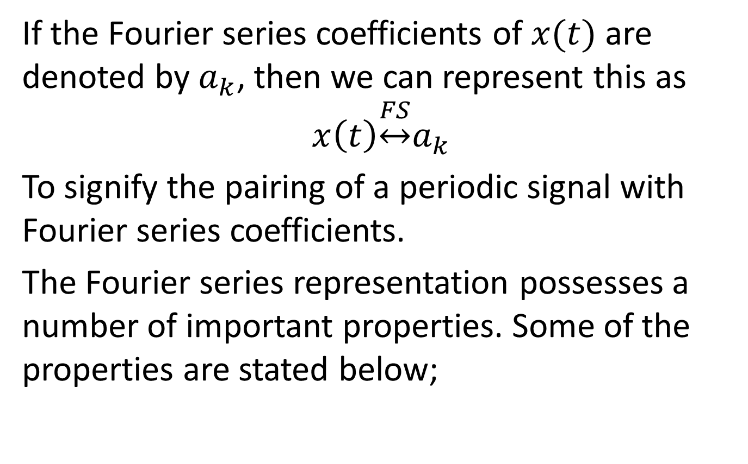
Properties of CT Fourier Series
If the Fourier series coefficients of $x(t)$ are denoted by $a_{k}$, then we can represent this as
$$x\left(t\right)\underset{↔}{FS}a_{k}$$
To signify the pairing of a periodic signal with Fourier series coefficients.
The Fourier series representation possesses a number of important properties. Some of the properties are stated below;

Slide 11
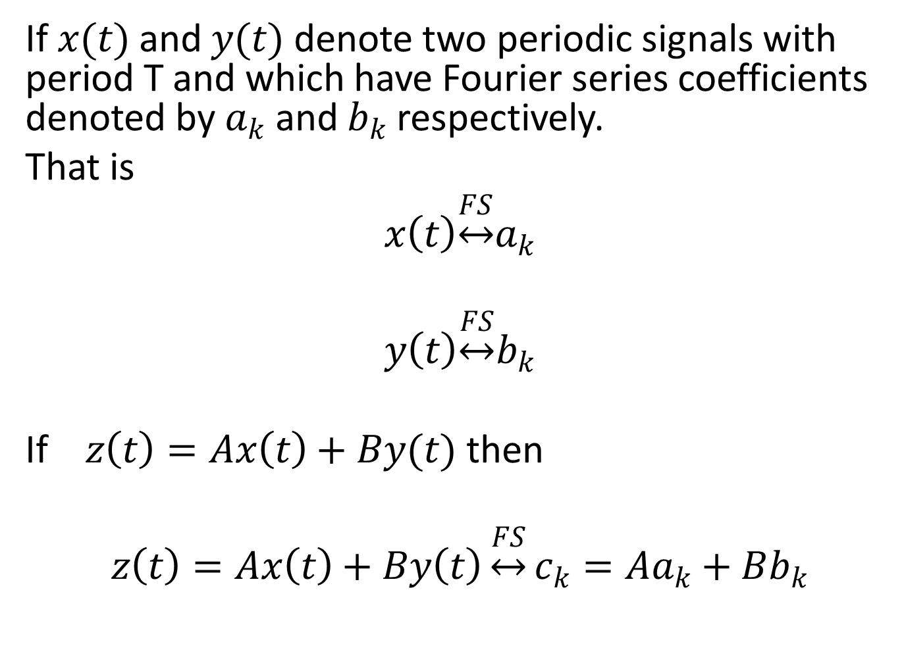
Linearity
If $x(t)$ and $y(t)$ denote two periodic signals with period T and which have Fourier series coefficients denoted by $a_{k}$ and $b_{k}$ respectively.
That is
$$x\left(t\right)\underset{↔}{FS}a_{k}$$
$$y\left(t\right)\underset{↔}{FS}b_{k}$$
If $z\left(t\right)=Ax\left(t\right)+By(t)$ then
$$z\left(t\right)=Ax\left(t\right)+By\left(t\right)\underset{↔}{FS}c_{k}=Aa_{k}+Bb_{k}$$

Slide 12
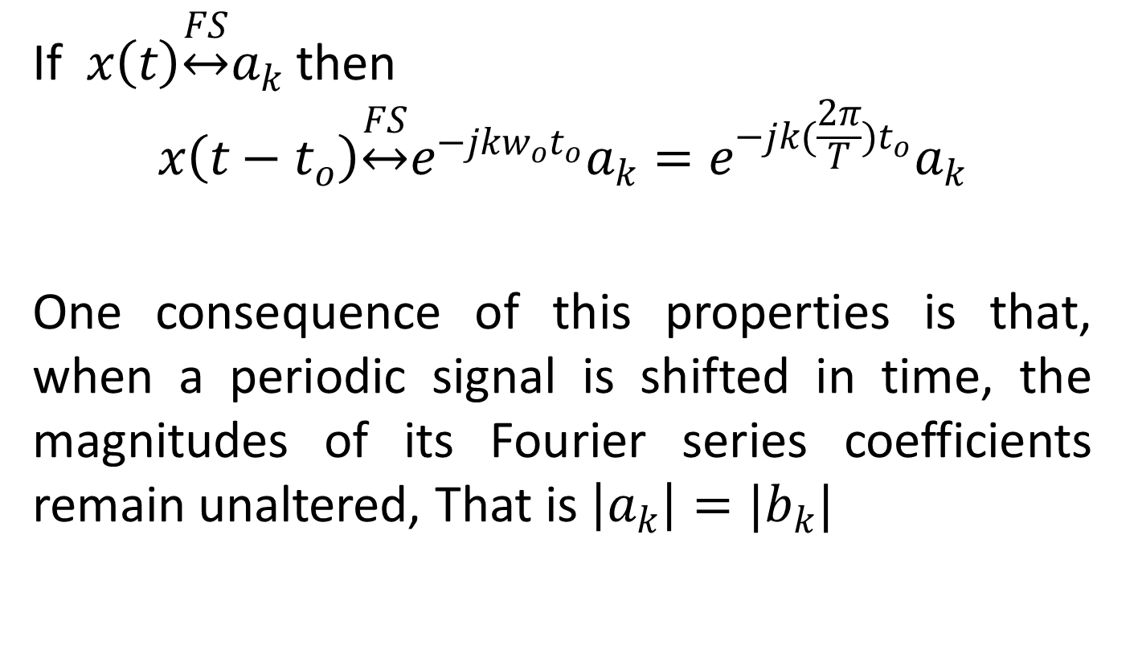
Time Shifting
If $x\left(t\right)\underset{↔}{FS}a_{k}$ then
$$x\left(t−t_{o}\right)\underset{↔}{FS}e^{−jkw_{o}t_{o}}a_{k}=e^{−jk(\frac{2π}{T})t_{o}}a_{k}$$
One consequence of this properties is that, when a periodic signal is shifted in time, the magnitudes of its Fourier series coefficients remain unaltered, That is $\left|a_{k}\right|=|b_{k}|$

Slide 13
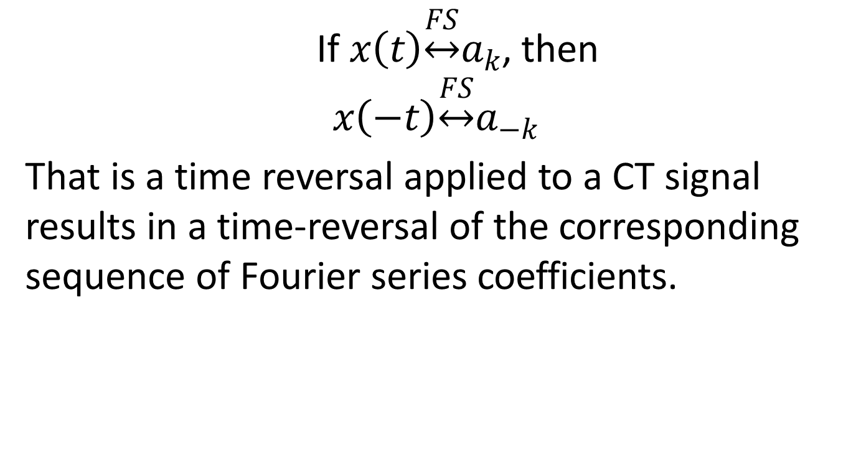
Time Reversal
If $x\left(t\right)\underset{↔}{FS}a_{k}$, then
$$x\left(−t\right)\underset{↔}{FS}a_{−k}$$
That is a time reversal applied to a CT signal results in a time-reversal of the corresponding sequence of Fourier series coefficients.

Slide 14
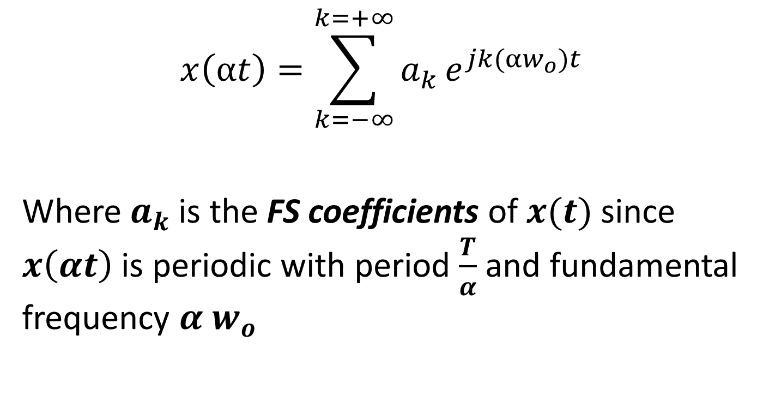
Time Scaling
$$x\left(αt\right)=\sum_{k=−∞}^{k=+∞}{a_{k}}e^{jk(αw_{o})t}$$
Where $a_{k}$ is the FS coefficients of $x(t)$ since $x\left(αt\right)$ is periodic with period $\frac{T}{α}$ and fundamental frequency $α w_{o}$

Slide 15

Multiplication
If $x\left(t\right)\underset{↔}{FS}a_{k}$
$$y\left(t\right)\underset{↔}{FS}b_{k}$$
Then
$x\left(t\right) y\left(t\right)\underset{↔}{FS}h_{k}=\sum_{l=−∞}^{∞}{a_{l}}b_{k−l}$

Slide 16

Conjugation and Conjugate symmetry
If $x\left(t\right)\underset{↔}{FS}a_{k}$,
then
$x^{∗}\left(t\right)\underset{↔}{FS}{a^{∗}}_{−k}$

